Slide 1
The word protein that I propose to you . . . I would wish to derive from
proteios, because it appears to be the primitive or principal substance
of animal nutrition that plants prepare for the herbivores, and which
the latter then furnish to the carnivores.
—J. J. Berzelius, letter to G. J. Mulder, 1838
H²O

Slide 2
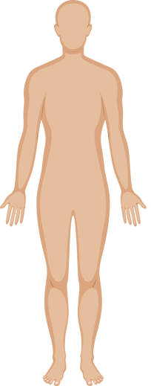
Functions of Proteins
Structural: Hair and nail
Brain and nerves
Enzymes
Muscles- actin, myosin
Blood- hemoglobin
Cellular messengers
Immunity- Antibodies

Slide 3
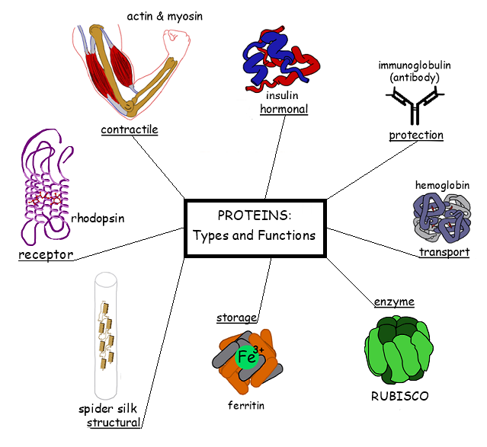

Slide 4
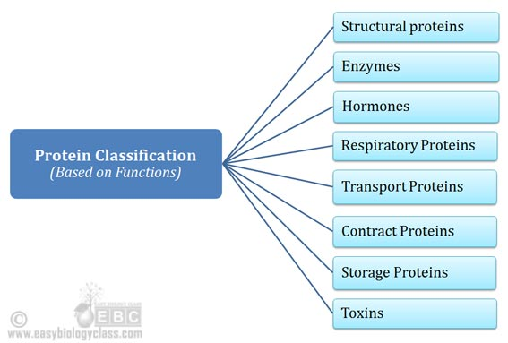
Classification of Proteins

Slide 5
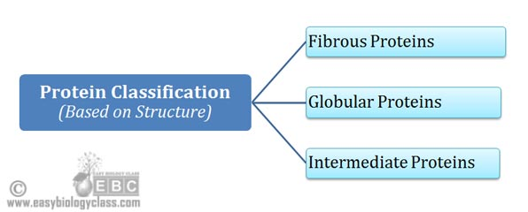
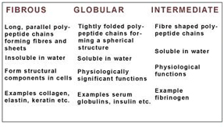
Classification of Proteins

Slide 6
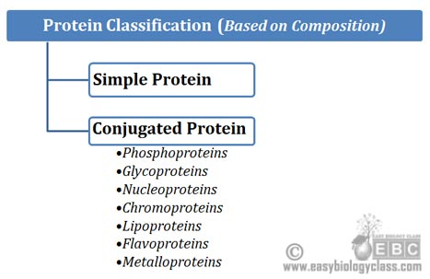
Classification of Proteins

Slide 7
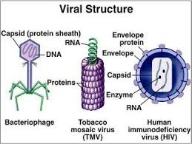
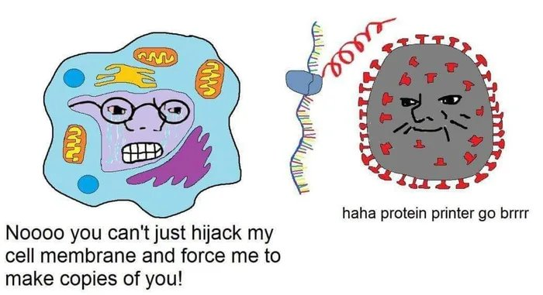

Slide 8
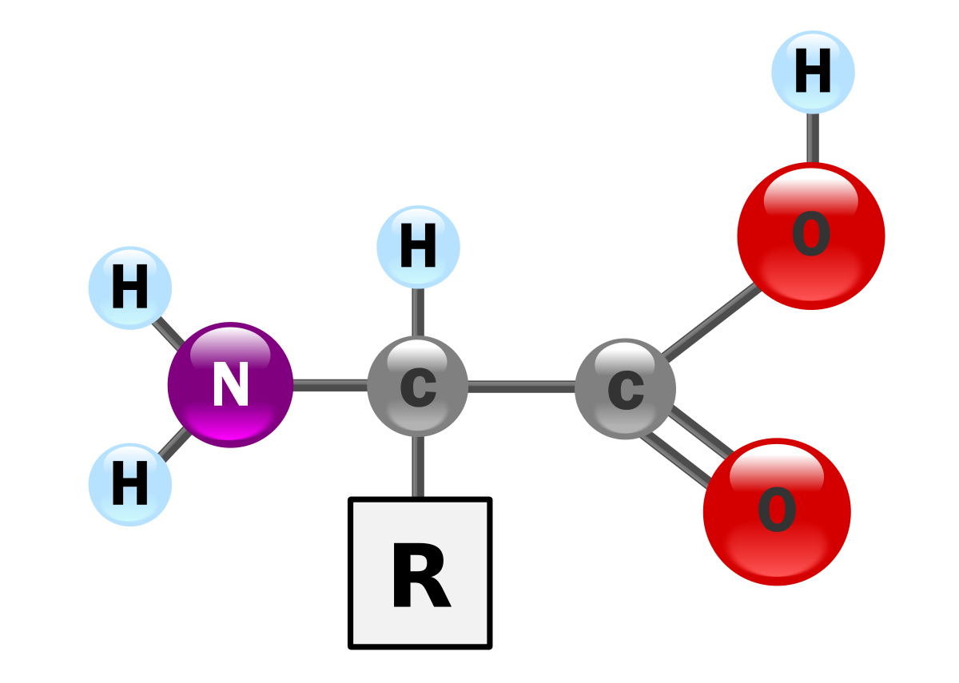
Building blocks of the building blocks

Slide 9
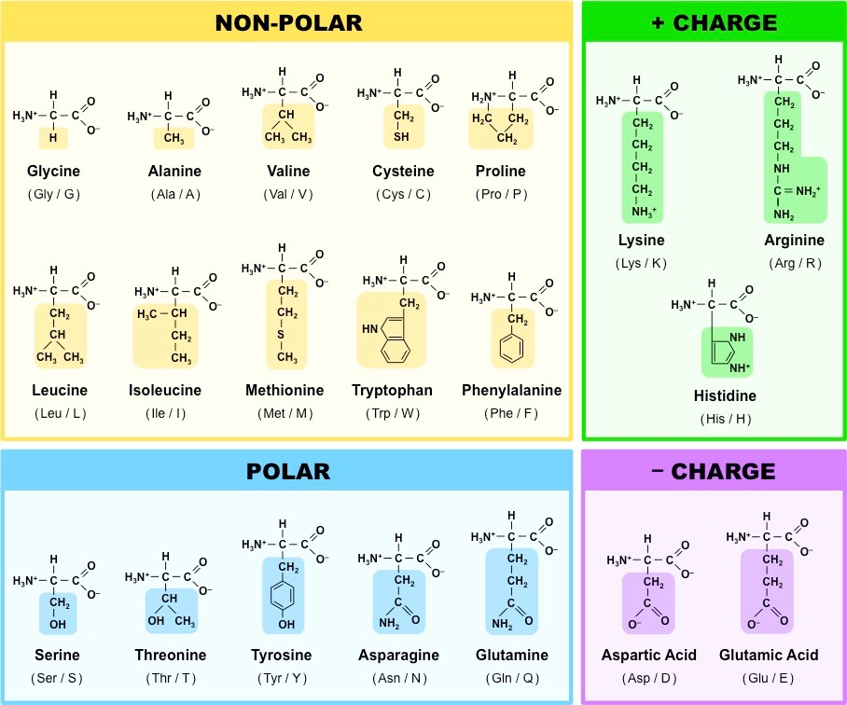

Slide 10
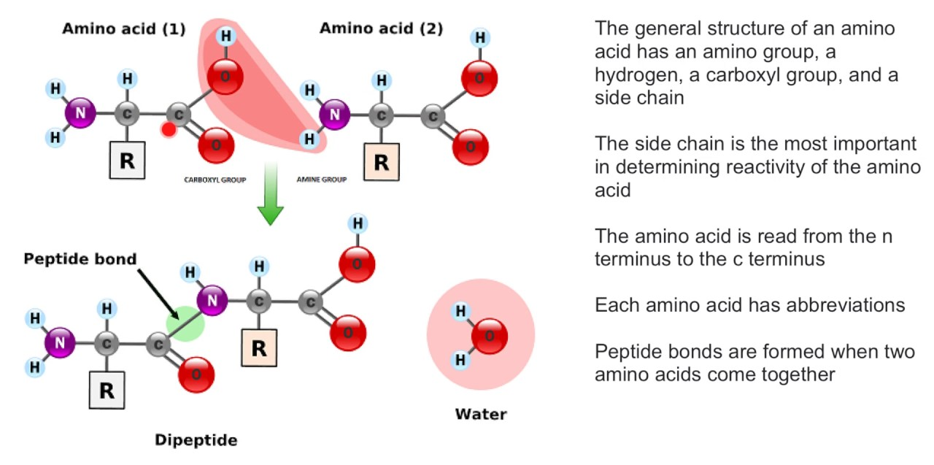
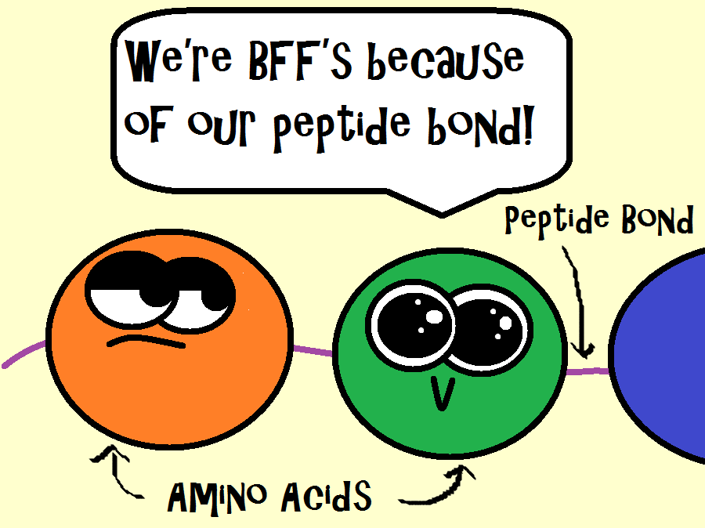
Peptide bond

Slide 11
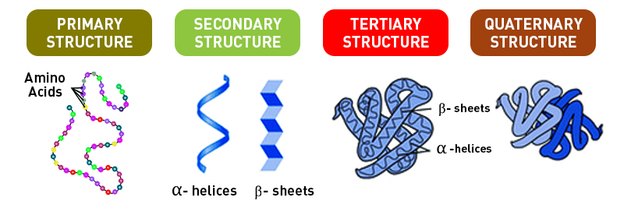
Protein folding and design

Slide 12
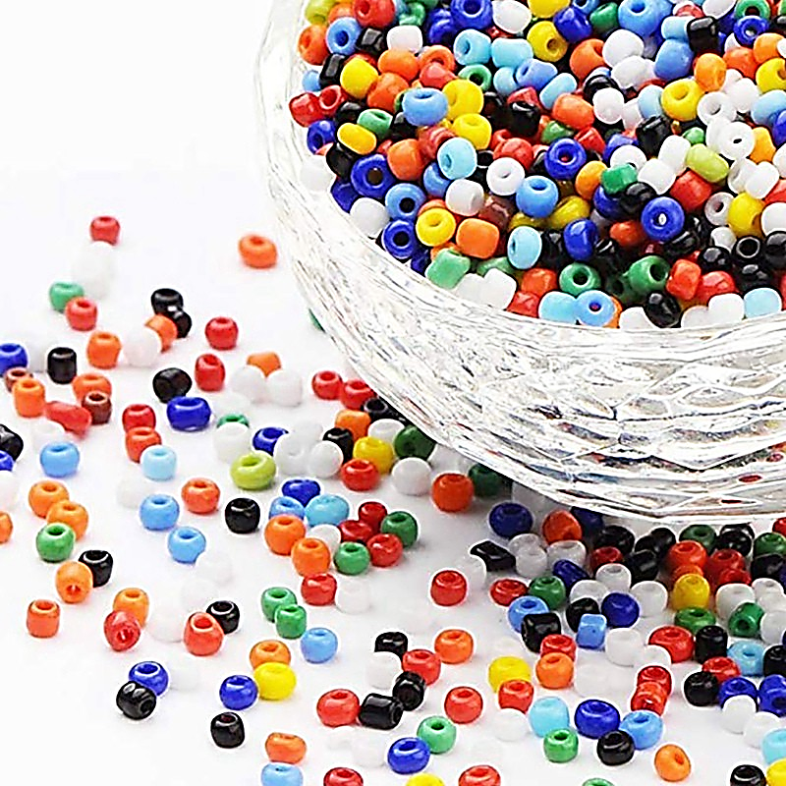

Slide 13
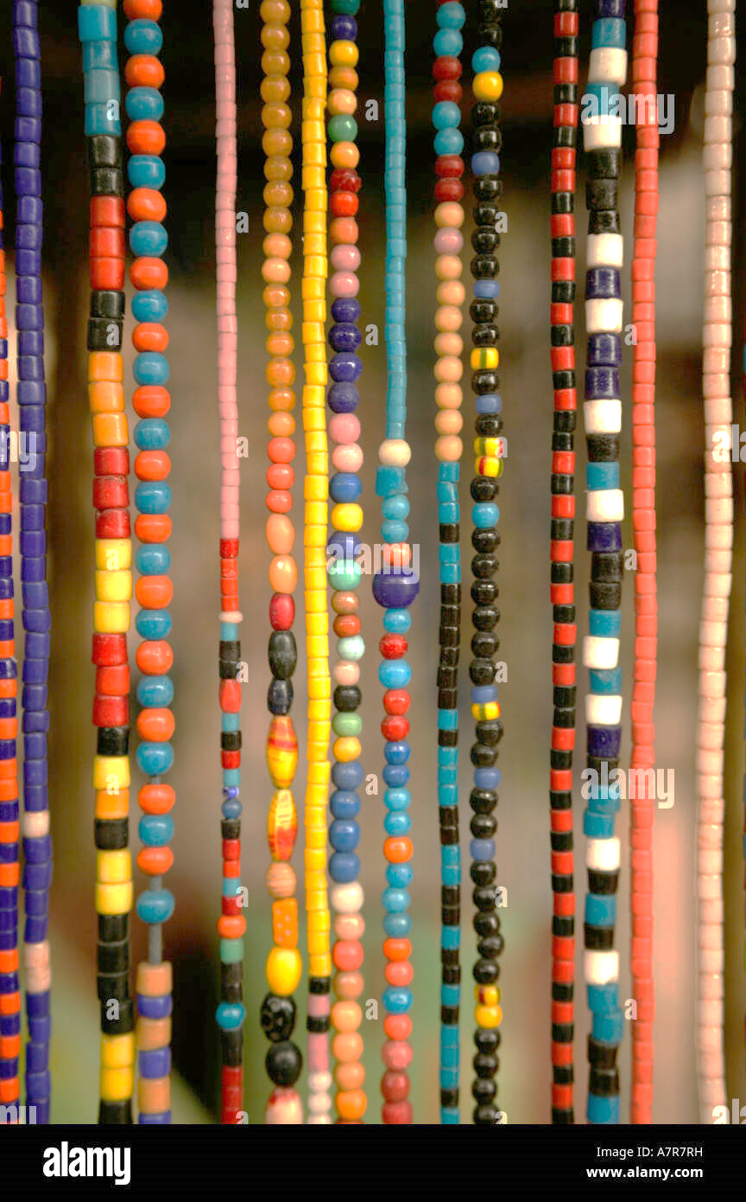

Slide 14
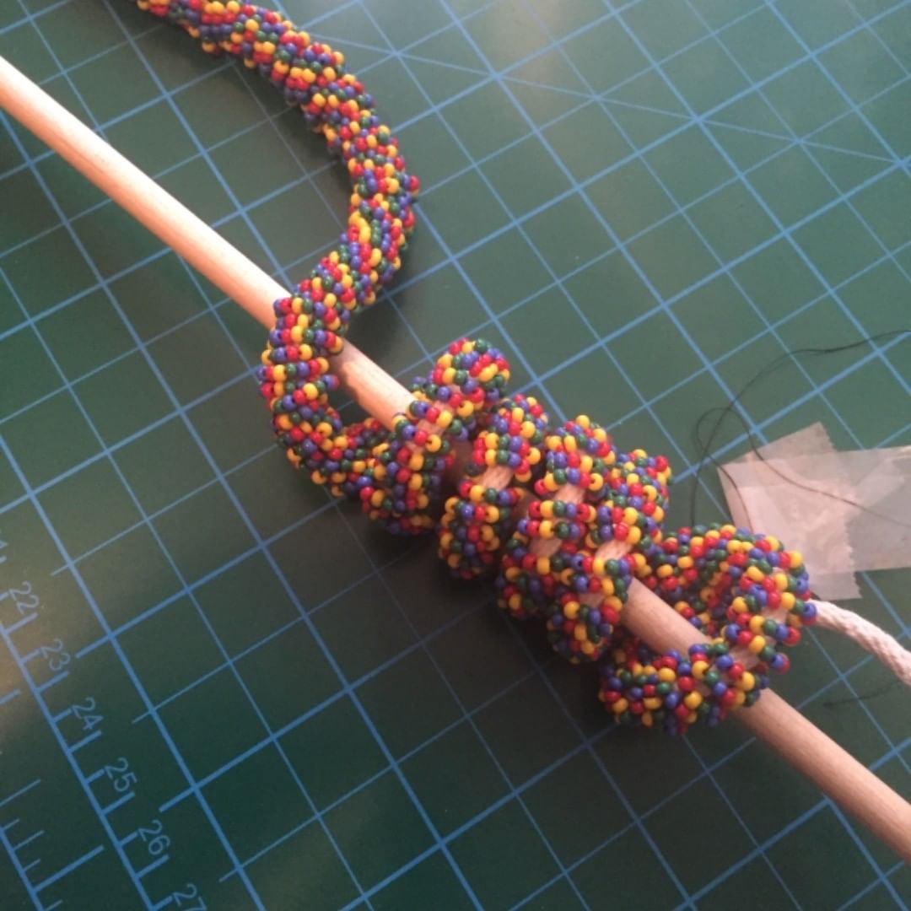

Slide 15
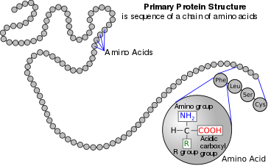
Building blocks of the building blocks
Amino acid, any of a group of organic molecules that consist of a basic amino group (−NH₂), an acidic carboxyl group (−COOH), and an organic R group (or side chain) that is unique to each amino acid. ... The amino acids differ from each other in the particular chemical structure of the R group.

Slide 16
Protein folding and design
Forces stabilizing Tertiary and quaternary structures:
Covalent interactions: Disulfide bridges
Weak interactions:
H- bonding, Vander wall’s interactions

Slide 18
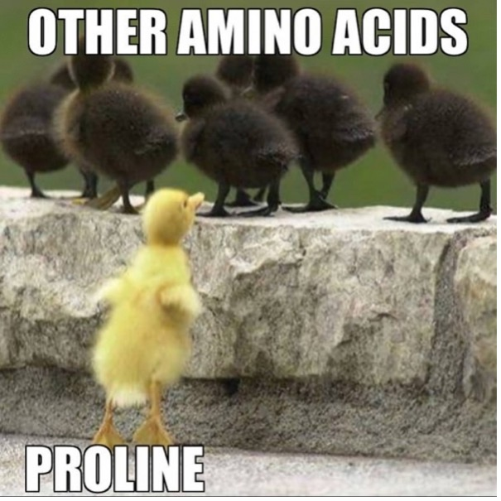

Slide 19
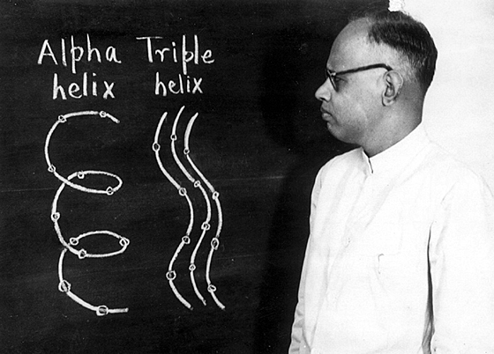

Slide 20
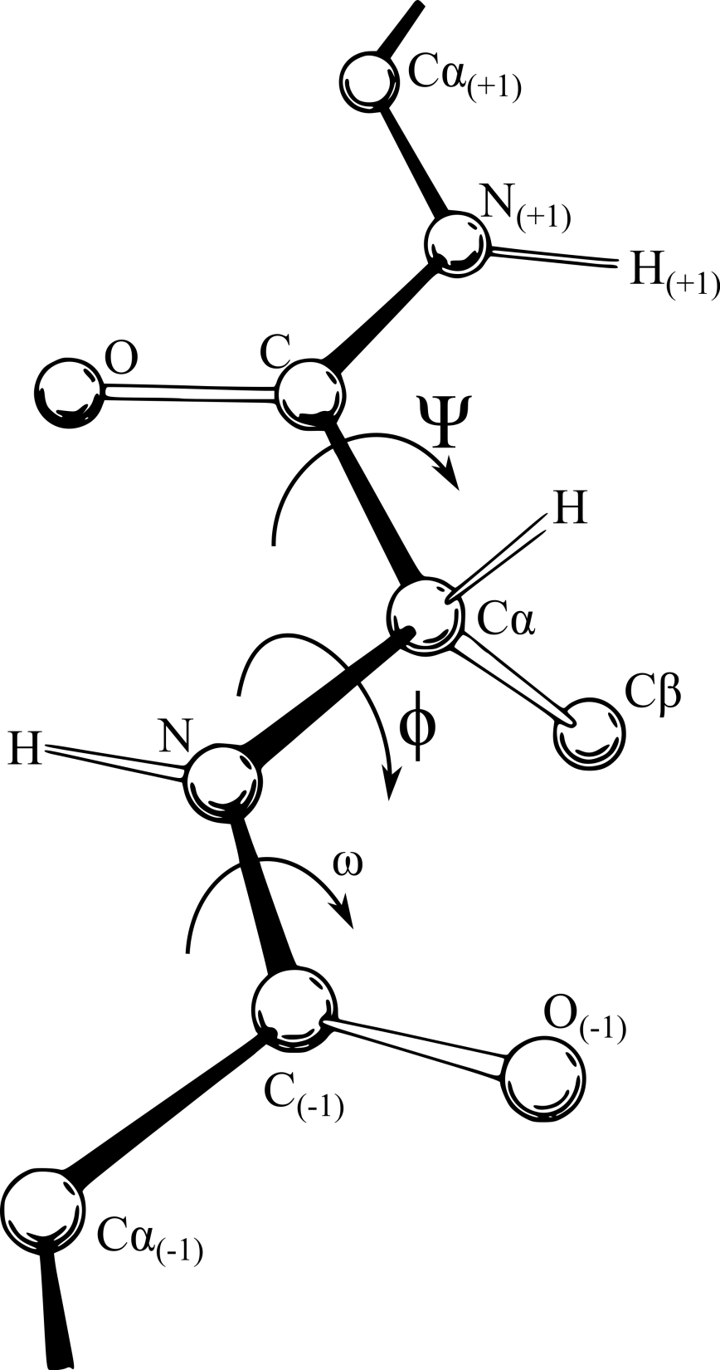
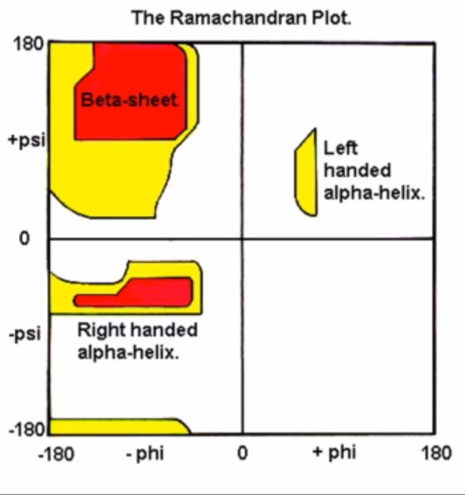
Predicting the structure

Slide 21
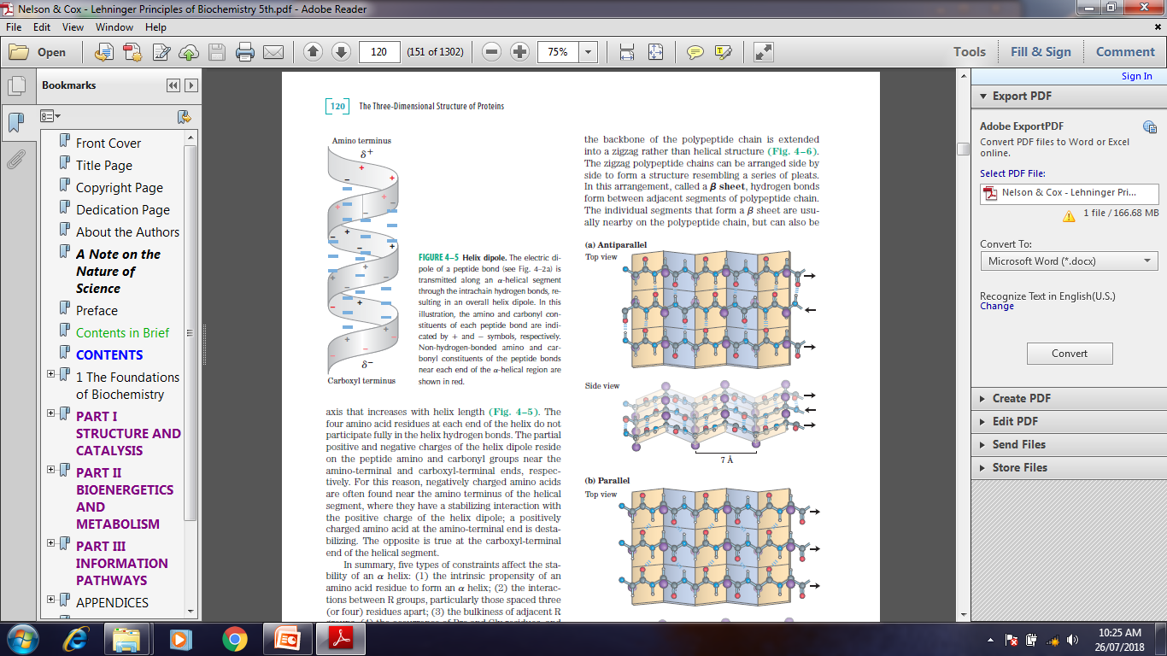
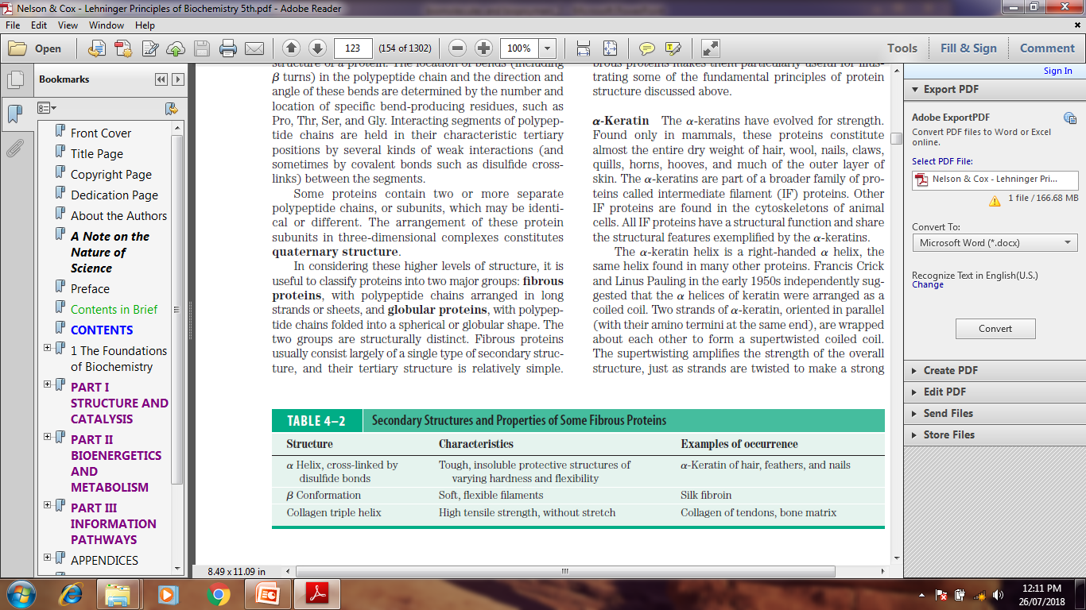
Alpha helix and Beta sheets
Helical Dipole

Slide 22
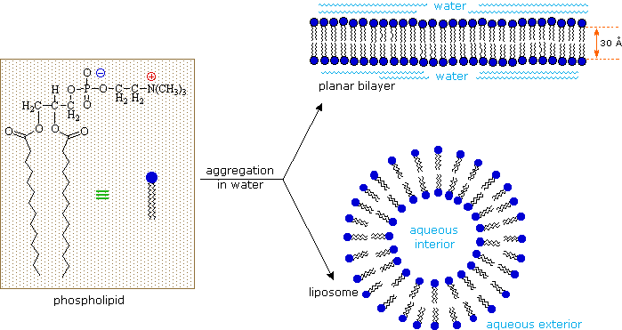
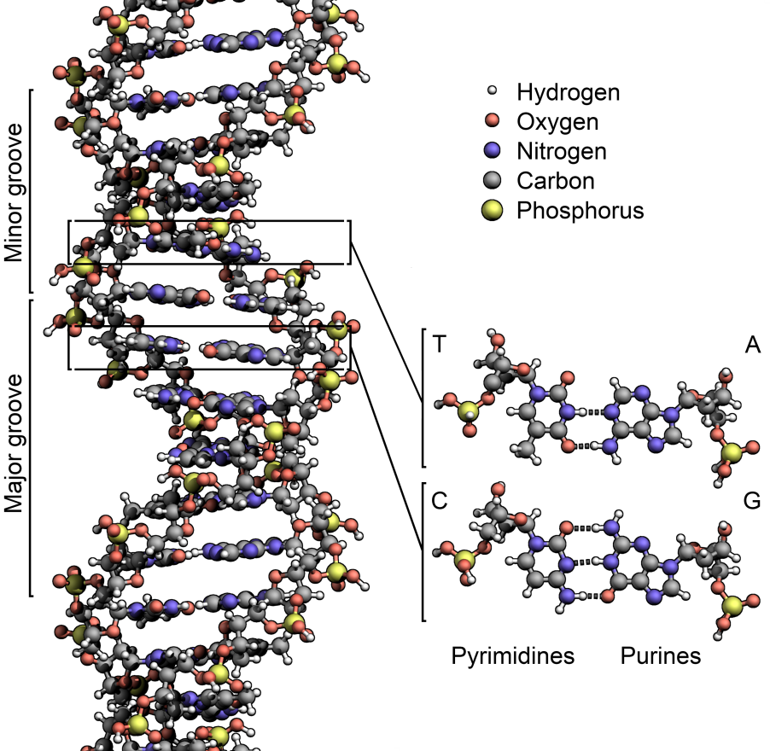
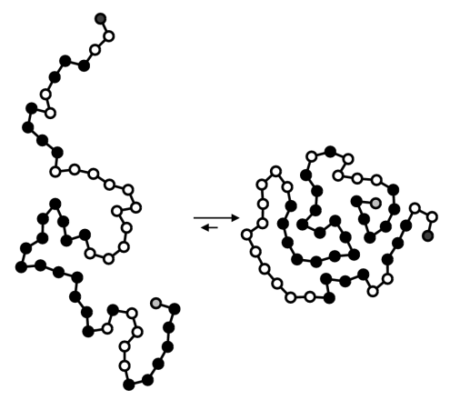
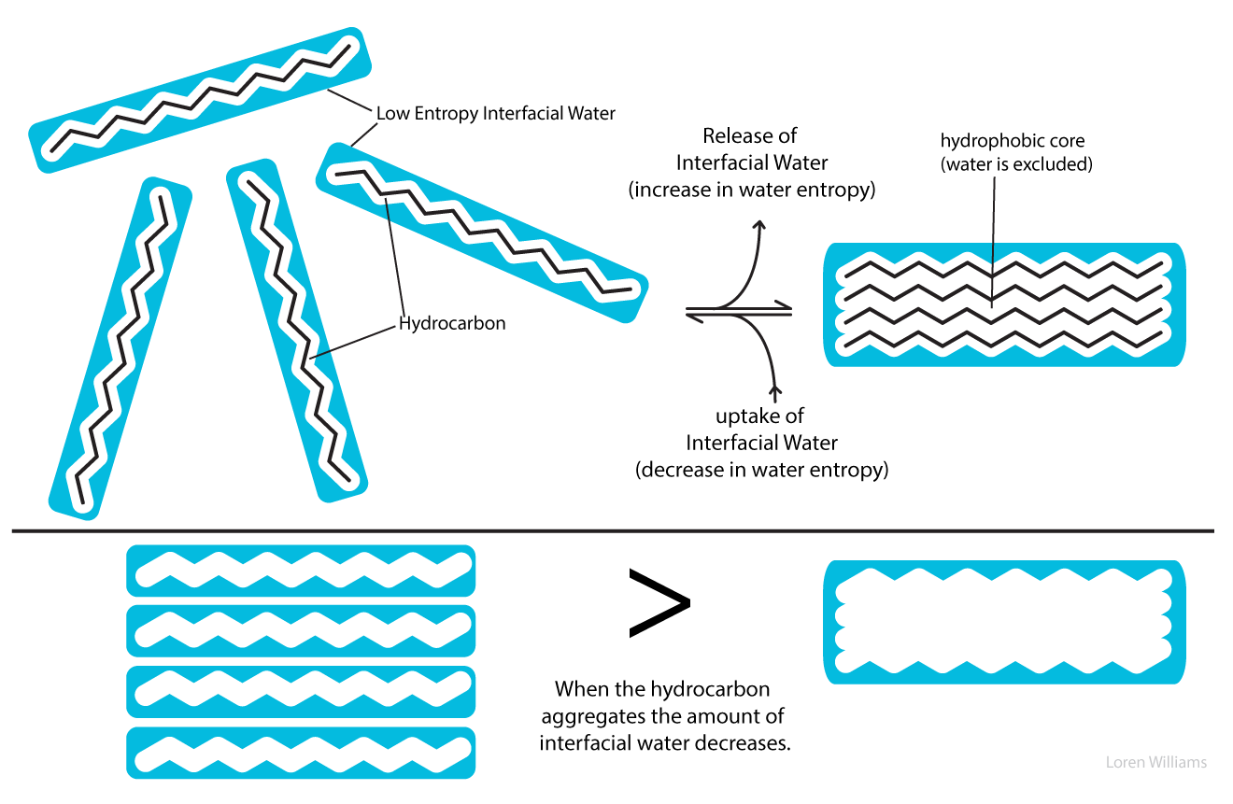
Interaction of water with other biomolecules
Organization of lipids in water
Organization of Nucleic acid in water
Organization of proteins in water

Slide 23
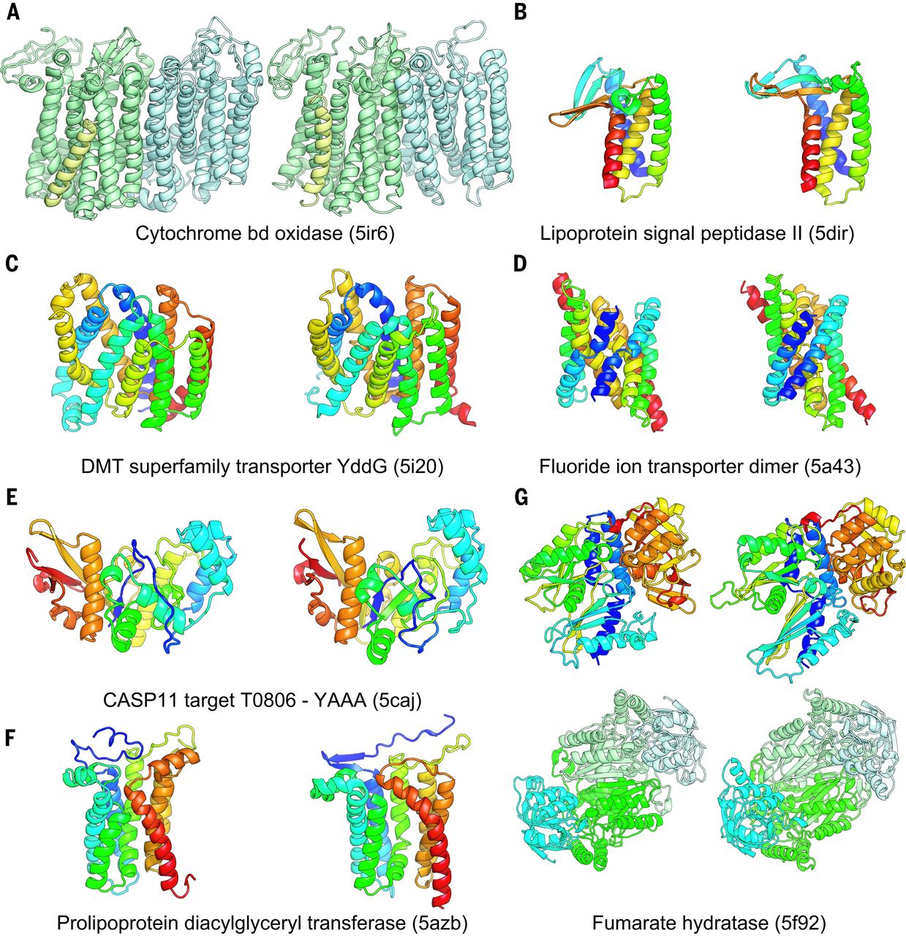
Tertiary and quaternary structure

Slide 24
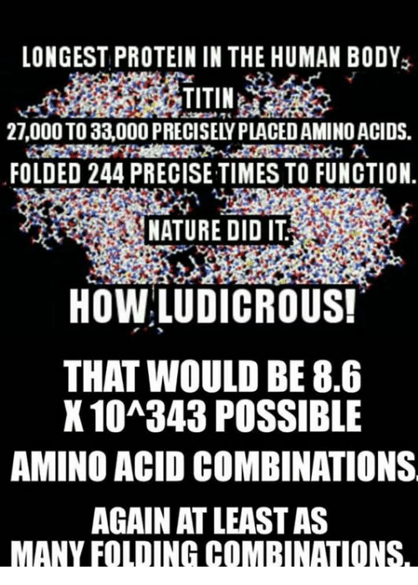

Slide 25
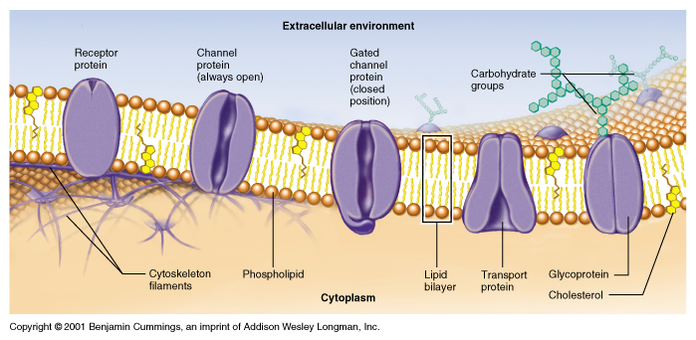

Slide 26
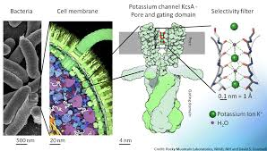
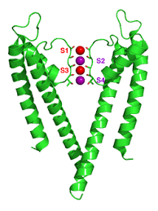
Structure function relationship

Slide 27
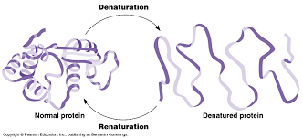

Slide 28
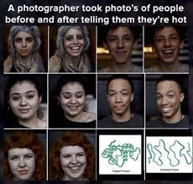

Slide 29
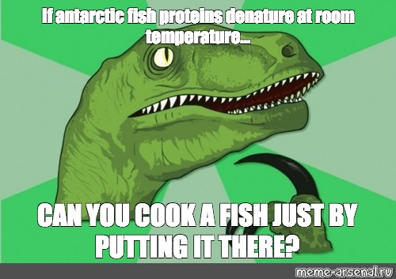

Slide 30
References:
1. Nelson And Cox, Lehninger Principles of Biochemistry, 6th edition
2. Springer- Advances in biochemical engineering in Biotechnology, Scheper, Plant Cells.
3. Bioinformatics: Joel Keizer
4. Images: Search engine Google.
Harper’s Biochemistry 26th Edition.
Genes- VIII, Lewin

Slide 32
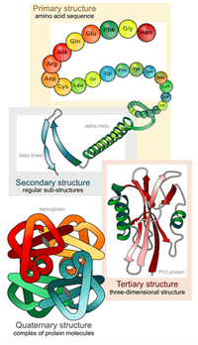

Slide 33
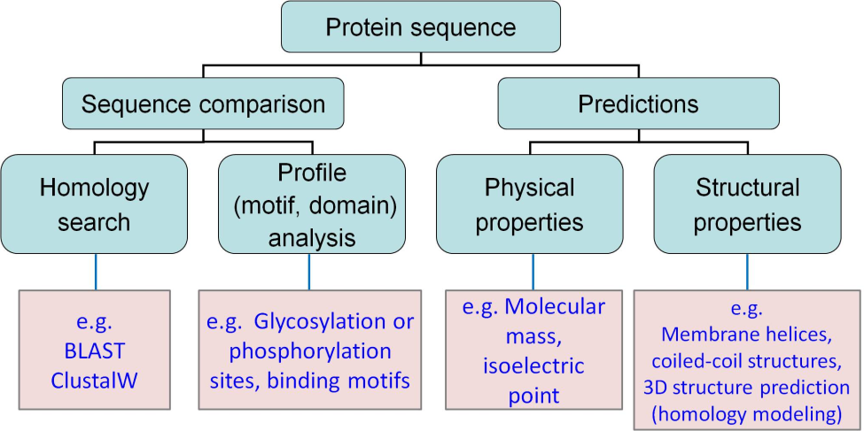
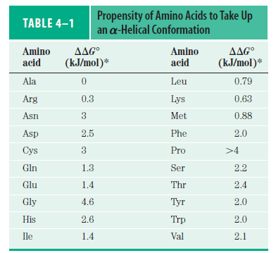
Bioinformatics- Computational methods to organize biological information
Protein Sequence Databases | Protein Structure Databases
>1 million sequences | > 300,000 structures
Swiss Prot, PIR International, OWL, NRDB, PROSITE, PRINTS | Protein Data Bank, CATH, SCOP, FSSP

Slide 34
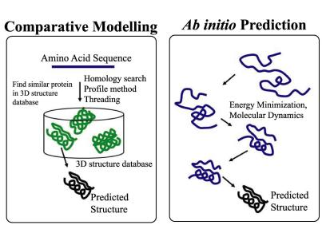
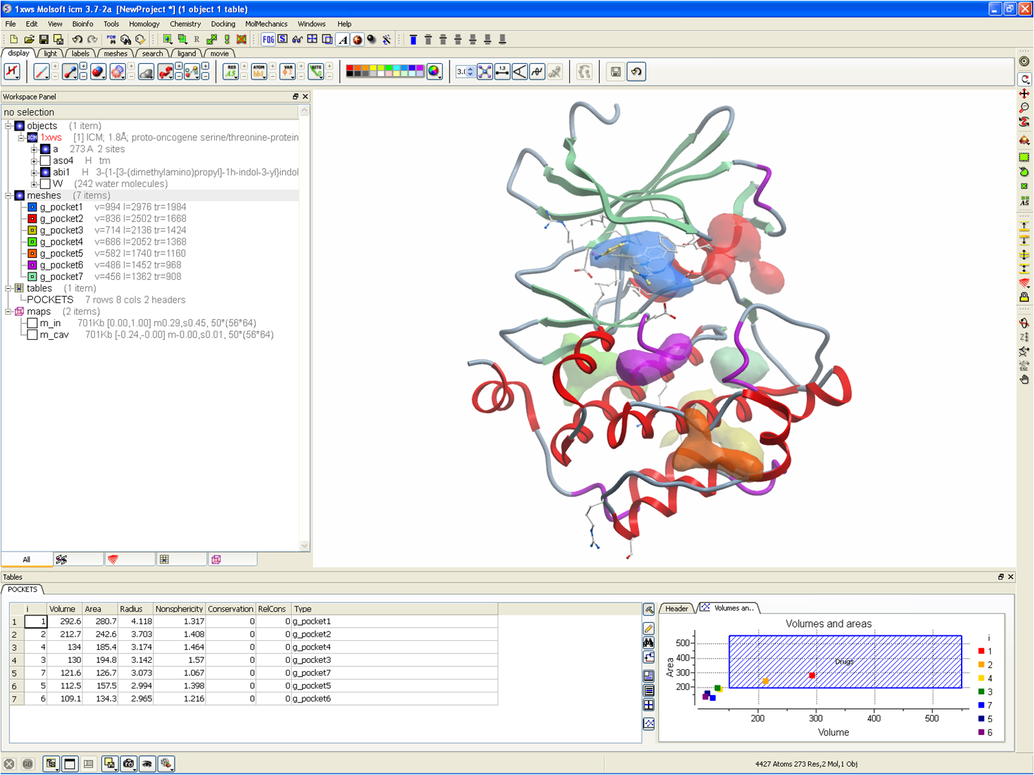
Predicting the structure

Slide 35
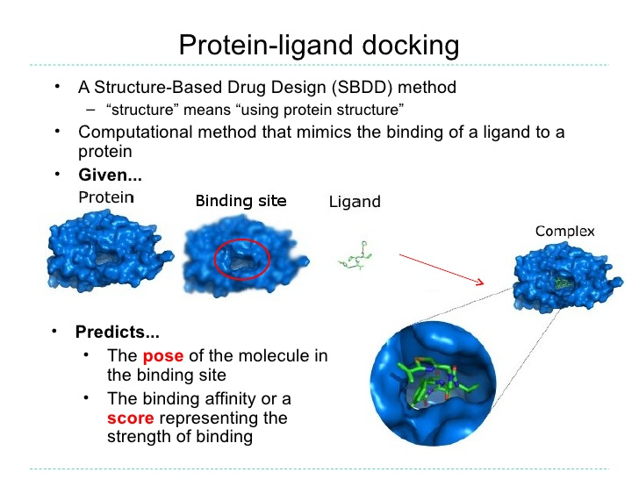
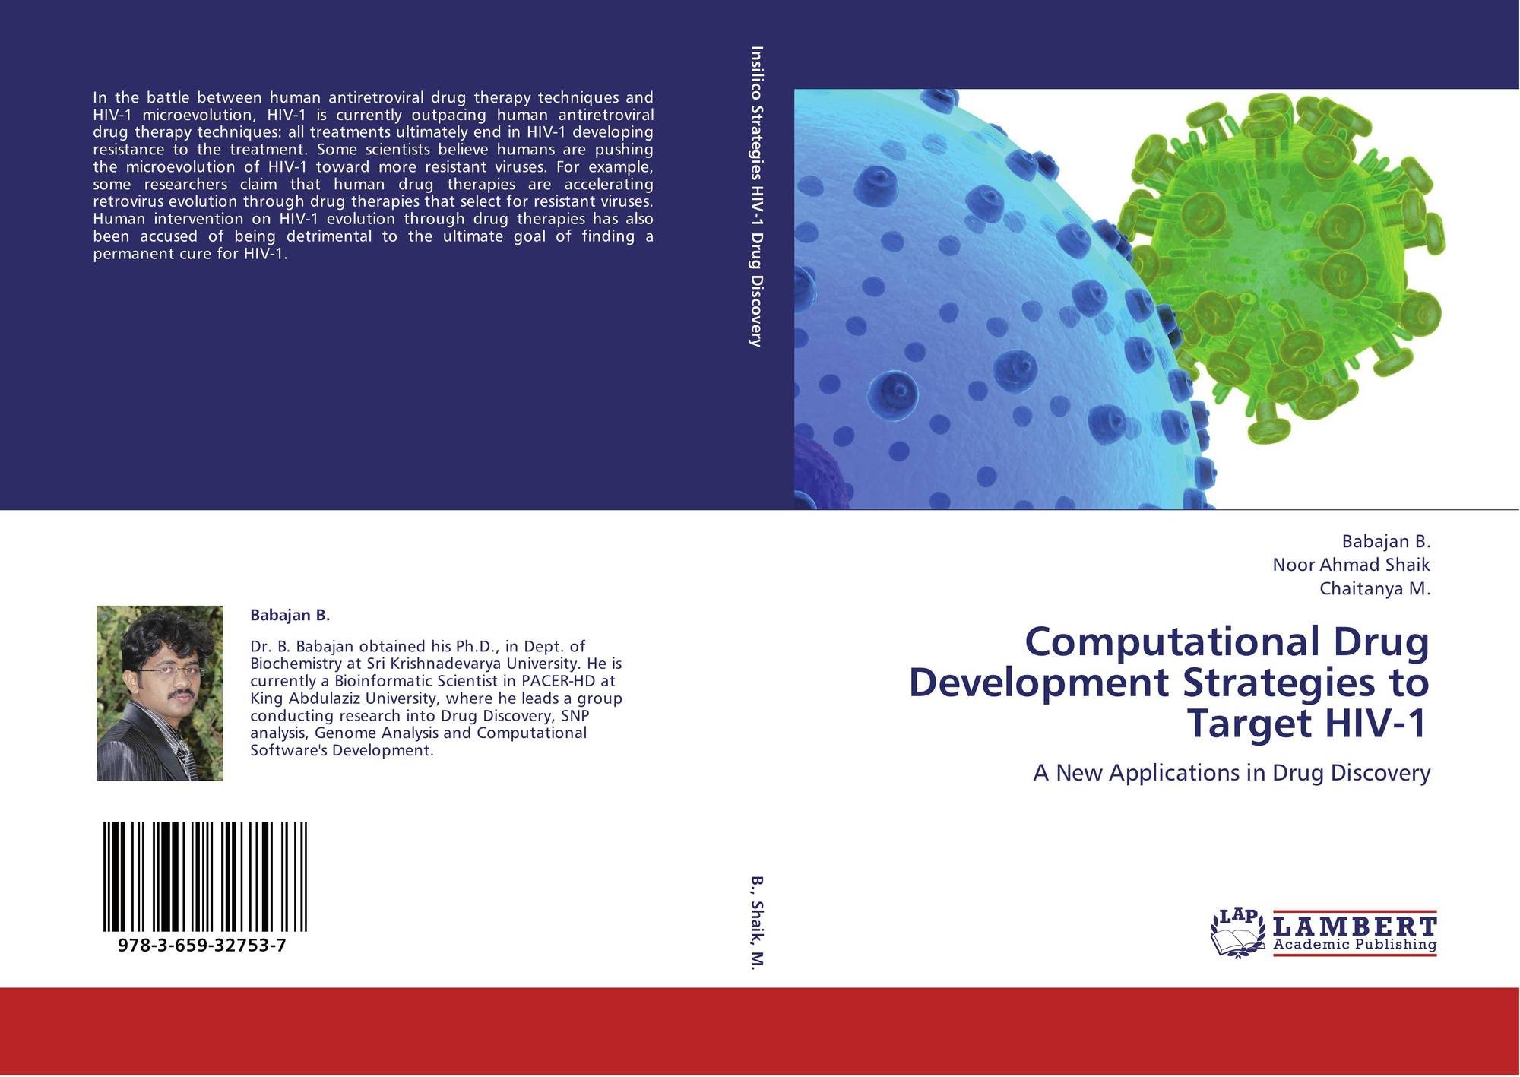
Computational drug design

Slide 36
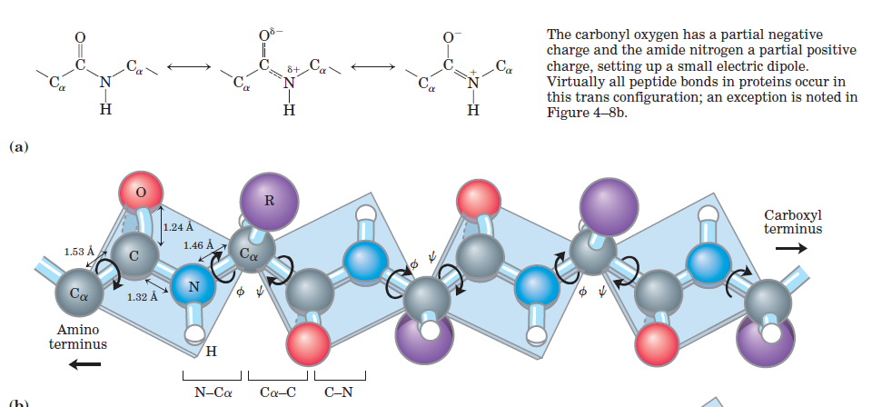
Peptide bond

